Slide 1


Santosh Kumar Kar,
skkar.2k2@gmail.com

Slide 2
CHAPTER – 3
Spring Boot Starter JDBC

Slide 3
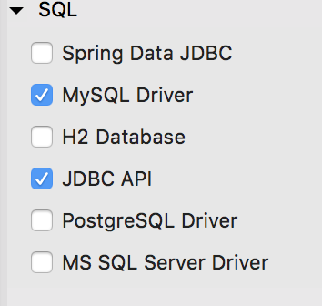
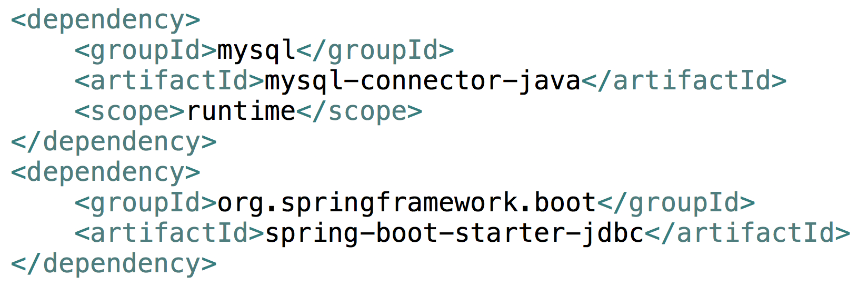
JDBC API
Now can @Autowire jdbcTemplate

Slide 4

Questions
Send to skkar.2k2@gmail.com

